Slide 1

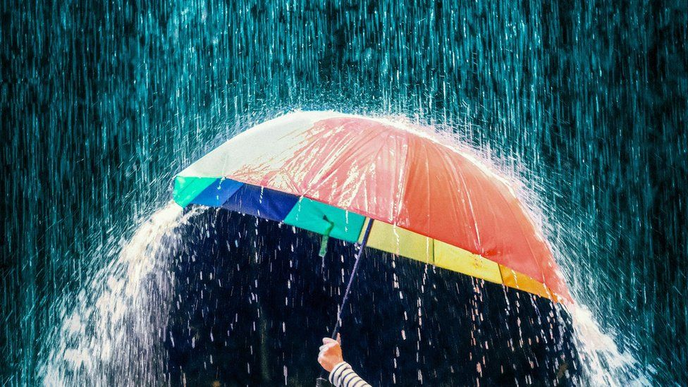
RainSense AI
Presented By:
Group 18

Slide 2
Problem Statement
Despite the evident importance of rainfall predictions, achieving a high level of accuracy remains a complex challenge.
Australia’s vast geographical expanse, diverse climatic zones, and unique weather patterns pose significant hurdles in accurately forecasting rainfall events.
This poses limitations on the ability of various sectors to plan effectively, allocate resources efficiently, and mitigate potential risks associated with extreme weather conditions.
The application of rainfall prediction spans a wide range of sectors and industries, playing a crucial role in decision-making and resource management. Agriculture, Water Resource Management, Urban Planning and Infrastructure, Disaster Management, and Energy sectors are the main application of rain predictions.

Slide 3
Final Goal
Our goal is to develop an accurate rainfall forecast classification model using key features like temperature, humidity, wind speed, and atmospheric pressure.
We aim to uncover patterns and correlations that contribute to precise rain prediction through advanced data exploration, feature engineering, and machine learning algorithms.
Compare the performance of the different approaches to solve the problem.

Slide 4
Proposed Methodology
Data Visualization, feature engineering, identifying most appropriate features.
Supervised learning: Decision Tree
Improving model by hyper parameter tuning
Semi-supervised learning : Decision Tree
Continuous iterations until desired high confidence
Unsupervised Learning
RNN model

Slide 5
Proposed Methodology
1
2
3
4
Dataset
Data
Preprocessing
Feature
Extraction
Model
building
Model
Testing
Result
With Evaluation matrix comparing the results

Slide 6
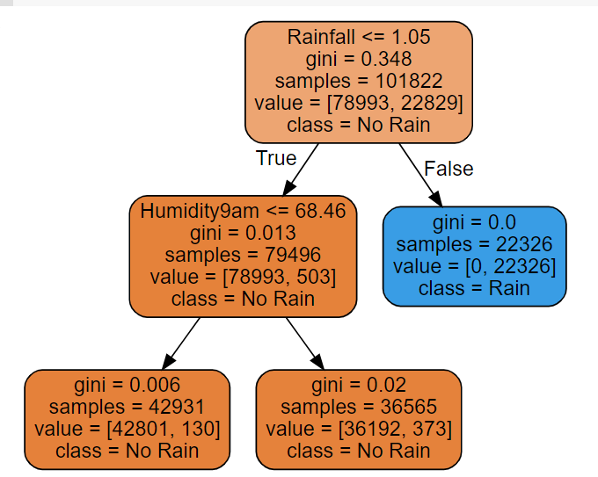

Supervised learning : Decision Tree
Feature engineering and extraction
Comparison of 2 models
Without parameter tuning
With hyper parameter tuning
K-cross Validation
Hyper-tuning parameters

Slide 7
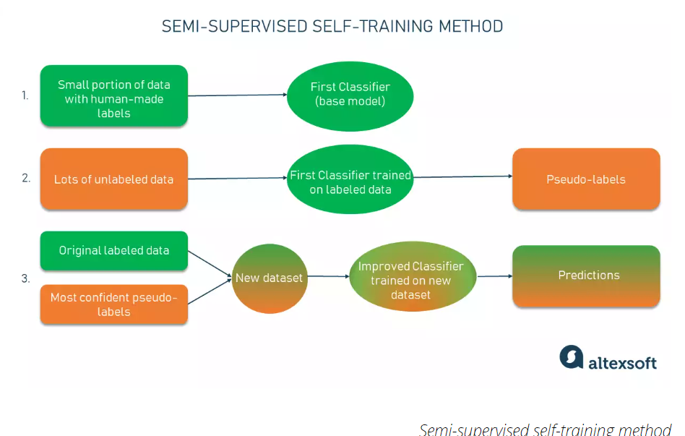
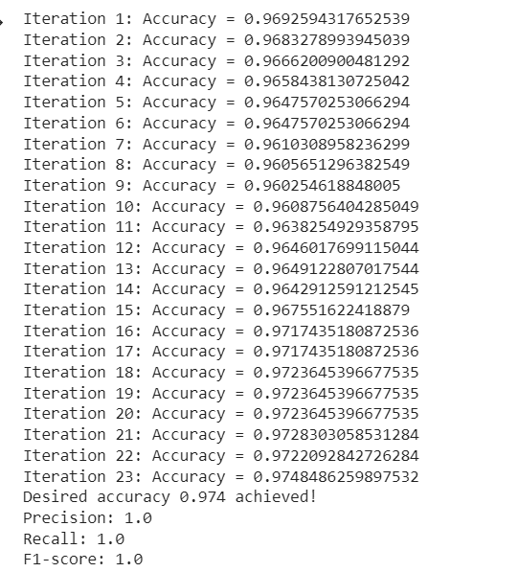
Semi-supervised Learning : Decision Tree
Labelled data -> 20 %
Unlabelled data -> 80%
Trained data -> 85%
Test data -> 15%
Iterations till desired accuracy of 0.974
https://www.altexsoft.com/blog/semi-supervised-learning/

Slide 8
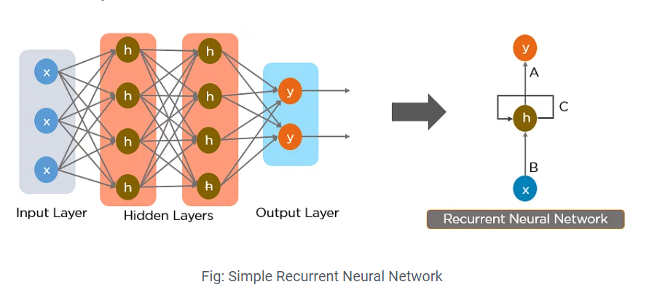
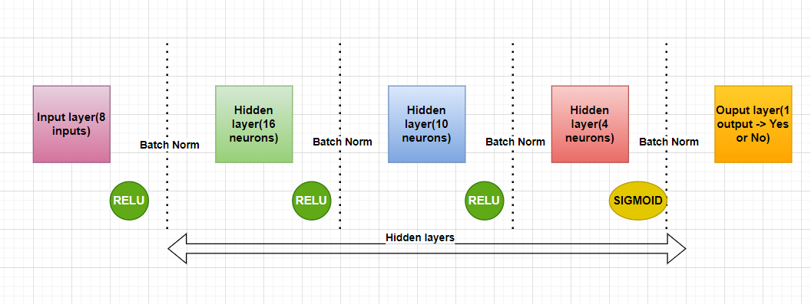
RNN
RNNs have the concept of “memory” that helps them store the states or information of previous inputs to generate the next output of the sequence.
Learning Rate = 0.001
Batch Norm
Adam optimizer
simplilearn

Slide 9
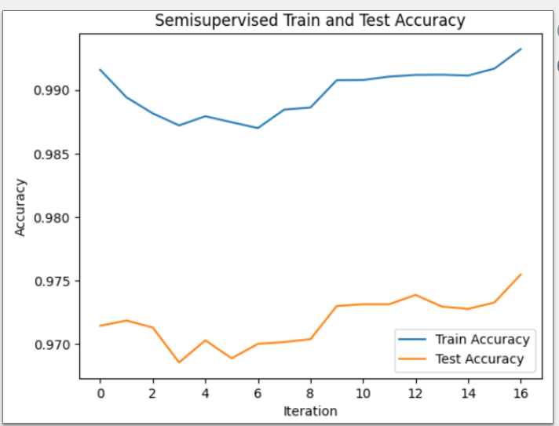
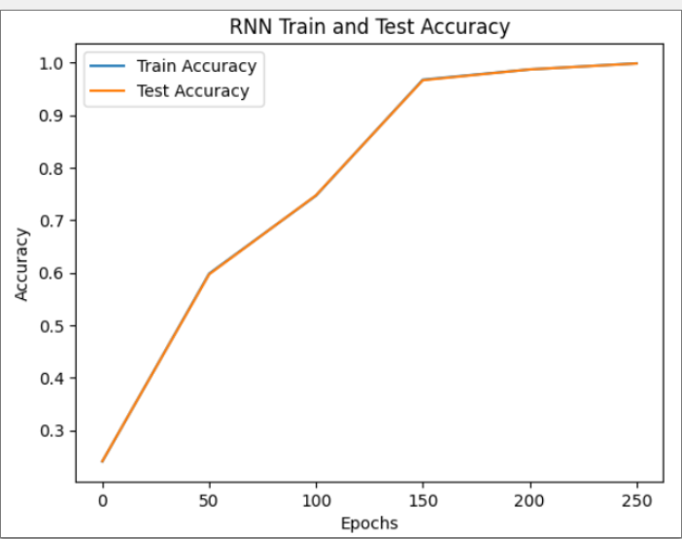
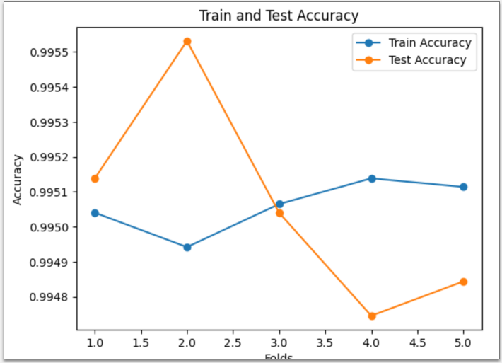
Comparison

Slide 10
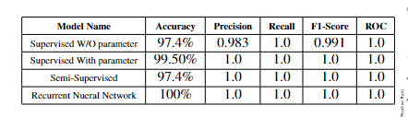
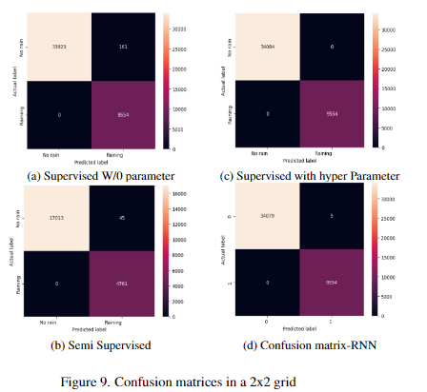
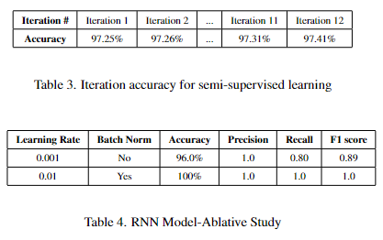
Results

Slide 11
Future works
With other algorithms, such as random forest, can evaluate the performance of the model.
Advanced feature engineering, ( merging different features to get new columns ) can make more effects on the model training
Adding more parameters for parameter tuning.

Slide 12
References
https://www.kaggle.com/datasets/jsphyg/weather-dataset-rattle-package
https://www.simplilearn.com/tutorials/deep-learning-tutorial/rnn#:~:text=RNN%20works%20on%20the%20principle,the%20output%20of%20the%20layer.&text=The%20nodes%20in%20different%20layers,layer%20of%20recurrent%20neural%20networks.
https://en.wikipedia.org/wiki/Decision_tree_learning
https://www.altexsoft.com/blog/semi-supervised-learning/

